Slide 1
Stacks and Queues

Slide 2
Introduction
When a problem is having been solved, some data are created and they must be processed in a specific order such as:
LIFO: Last In First Out ← Figure of a stack
FIFO: First In First Out ← Figure of a queue.
Stacks and Queues are lists in which the way of adding or removing an element must follow pre-defined rules (LIFO or FIFO). So, they are restricted lists.
In this topic, ways to create stacks and queues in a program are introduced.

Slide 3
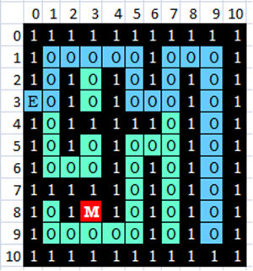
Introduction…
How to Find a Treasure (Money) or To Exit a Maze
The problem can be solve by trial and error approach(THỬ VÀ SAI-mò) using a Stack.
At each crossroad, a position is chosen and OTHERS must be saved.
Example:
From the Entry (3,0), going to the position (3,1). There are two options, the position (2,1) is chosen and the position (4,1) is saved.
If the blue path is chosen, positions must be saved are:
(4,7)
(2,3)
(4,1)
At the dead position, (9,9), the next examined position is chosen is (4,7)

Slide 4
Learning Outcomes
LO2.1 Define stack and queue.
LO2.2 List and demonstrate the operations common to stacks and queues.
LO2.3 Describe specific tasks to which stacks and queues are suited.
LO2.4 Apply stacks to a specific application.
LO2.5 Apply queues to a specific application.
LO2.6 Write programs to implement stack and queue in Java programming language.
LO2.7 Define and explain the need of priority queue.

Slide 5
Contents
1- Stacks
2- Queues
3- Priority Queues
Exercises: 6 assignments in demonstrations.
Notes:
Maze: mê cung

Slide 6
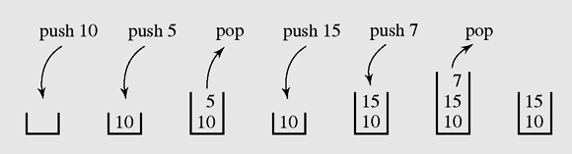
1- Stacks
A stack is a linear data structure that can be accessed only at one of its ends for storing and retrieving data.
A stack is called an LIFO structure: last in/first out
A series of operations executed on a stack

Slide 7
Stacks…
Where a stack should be used?
Stack should be used when processing order of data is opposed to creating order.
n= 12 : 2
0 6 : 2
0 3 : 2
1 1 : 2
1
base=2
Convert a positive number to a binary string.
1100
1
1
0
0

Slide 8
Stacks: How to Implement a stack?
Step 1: Choose a linear storage (an array or a linked list).
Step 2: Implements basic methods which will make a list as a stacks such as:
clear() — Clear the stack
isEmpty() — Check to see if the stack is empty
push(el) — Put the element el on the top of the stack
pop() — Take the topmost element from the stack
topEl() — Return the topmost element in the stack without removing it
The LIFO mechanism is implemented in methods push(…) and pop(…).

Slide 9
Stacks: How to Implement a Stack?
Comparing Array Stack vs Linked-list Stack
Stack | Using array → linear group | Using linked list → linear group | Evaluating
Memory allocation | Stack size must be predicted | Memory of an element will be allocated when needed | LL stack is more flexible than array stack.
Basic methods: push(x) pop() | Add to the end → push(x) → O(1) Remove from end → pop() →O(1) | Add to the end → O(1) Remove from end → O(1) OR Add to the head → O(1) Remove from the head → O(1) | With respect to performance, they are the same

Slide 10
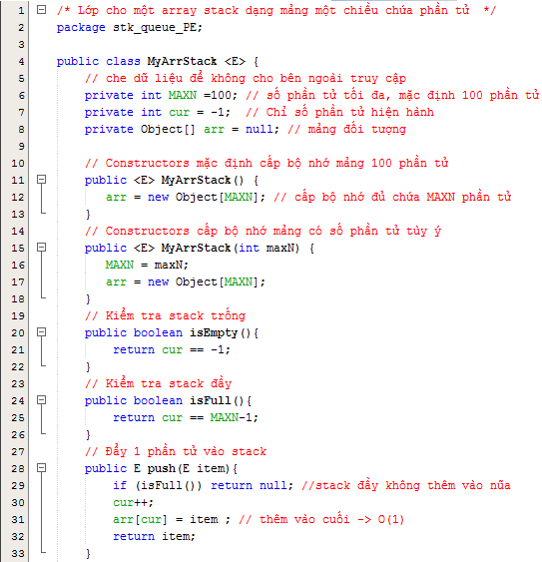
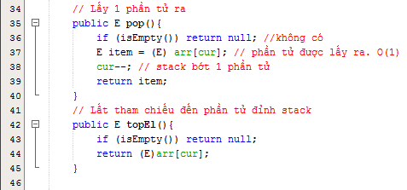
Stacks: Demo 1- Array Stack

Slide 11
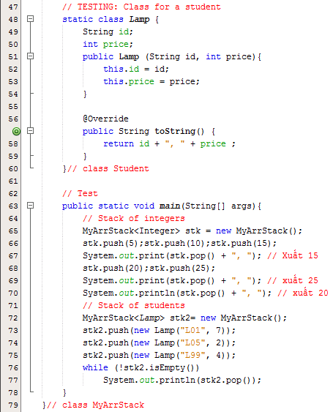
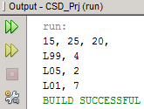
Stacks: Demo 1- Array Stack
5 10 15
5 10 ➔ 15
5 10 20 25
5 10 20 ➔ 25
5 10 ➔ 20

Slide 12
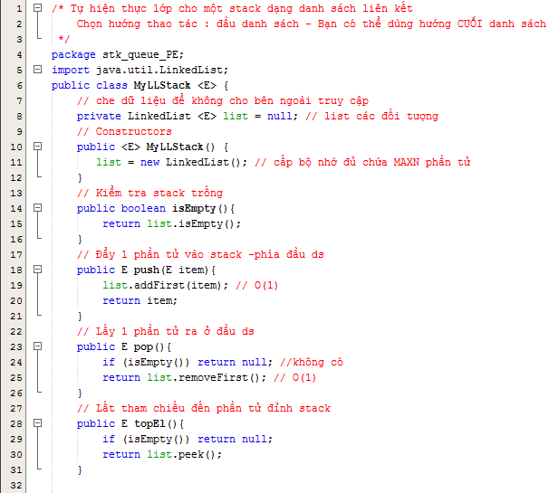
Stacks: Demo 2- Linked List Stack

Slide 13
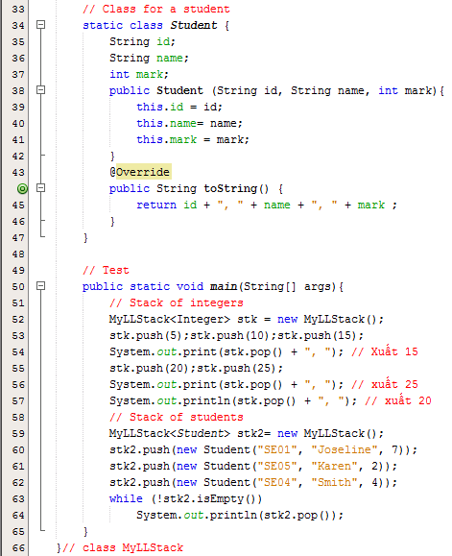
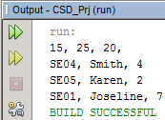
Stacks: Demo 2- Linked List Stack

Slide 14
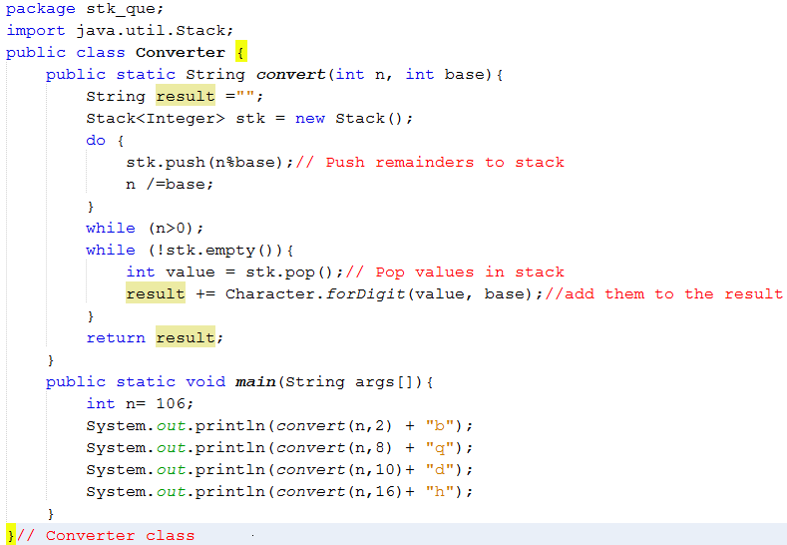
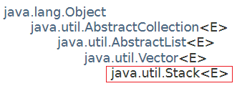
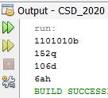
Stacks: Demo 3
Problem: Convert a positive integer to b-based num string
The java.util.Stack class uses an array in it’s implementation.

Slide 15
Stacks: …
Matching delimiters- A way to use stacks
a = b + (c – d ) * (e – f);
g[10] = h[i[9]] + (j + k) * l;
while (m < (n[8] + o)) { p = 7; r = 6; }
a = b + (c – d) * (e – f));
g[10] = h[i[9]] + j + k) * l;
while (m < (n[8] + o]) { p = 7; r = 6; }
while (m < (n[8] + o))
Matched
Mismatched
Nested matched
Algorithm for delimiter matching : refer to the page 142.

Slide 16
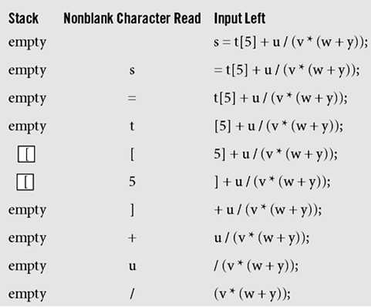
Stacks…
Push to the stack an open delimiter and pop it from the stack when appropriate close delemiter is detected in input string
Processing the statement s=t[5]+u/(v*(w+y));
with the algorithm delimiterMatching()

Slide 17
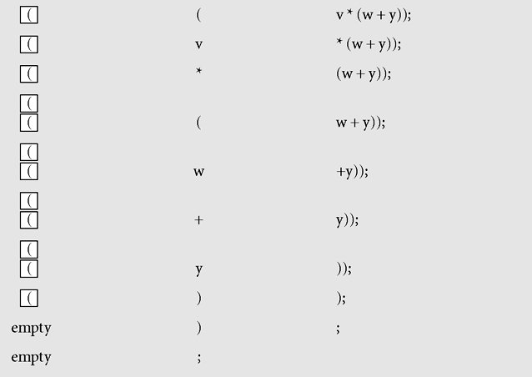
Stacks…
Figure 4-2 Processing the statement s=t[5]+u/(v*(w+y));
with the algorithm delimiterMatching()

Slide 18
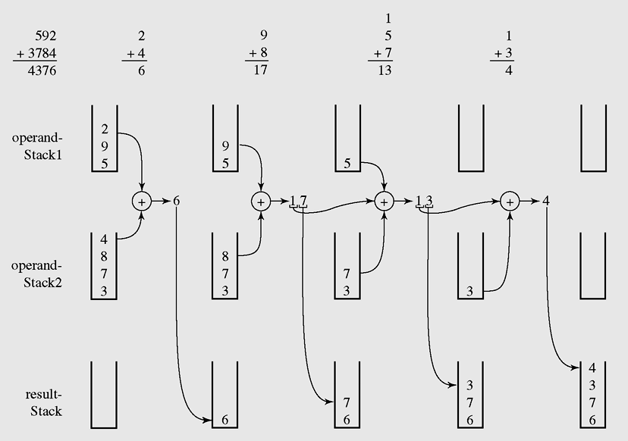
Stacks: Demo 4
Adding two 10-based string numbers
Carry=0
Carry=0
Carry=1
Carry=1
Pop all elements in the result-stack to make the final result
An example of adding string numbers “592” and “3784” using stacks

Slide 19
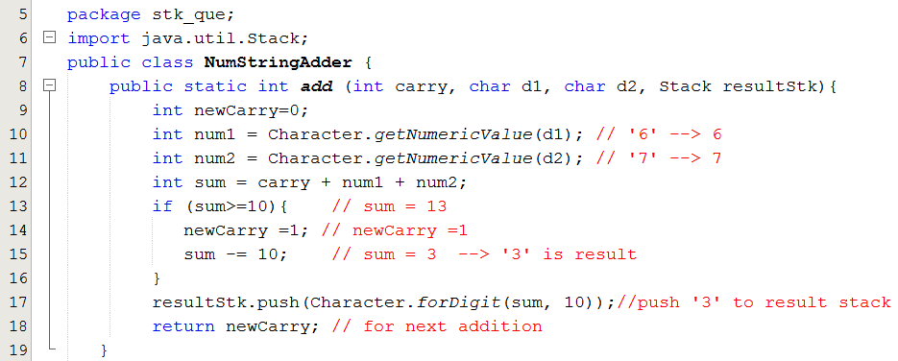
Stacks: Demo 4
Adding 2 digit with specific carry and result digit is put to result stack.
New carry is the return value.

Slide 20
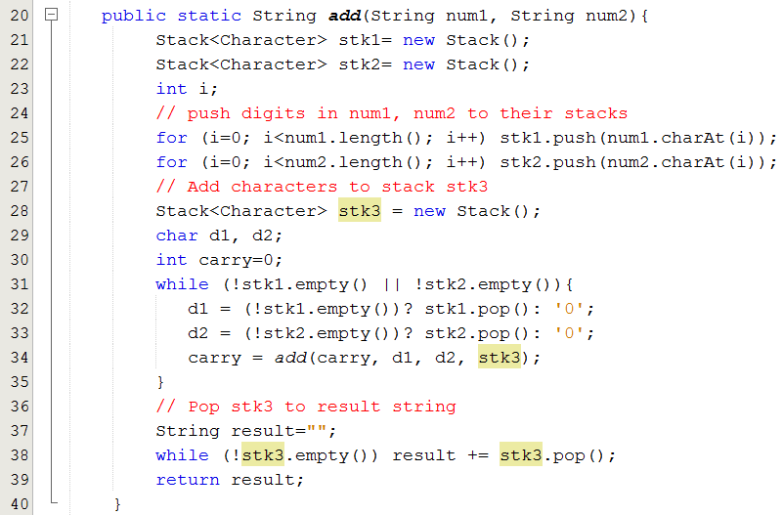
Stacks: Demo 4
Adding 2 string numbers. Result string number is returned.

Slide 21
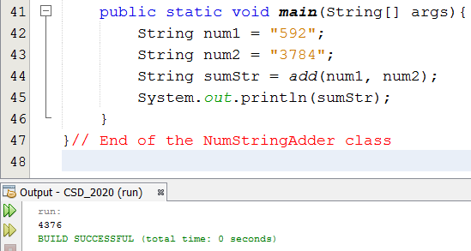
Stacks: Demo 4
Test program: “592” + “3784” → “4376”

Slide 22
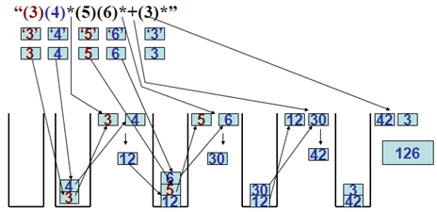
Stack: Demo 5.
Evaluating a simple postfix expression using stack.
StringTokenizer:
3
4
*
5
6
*
+
3
*

Slide 23
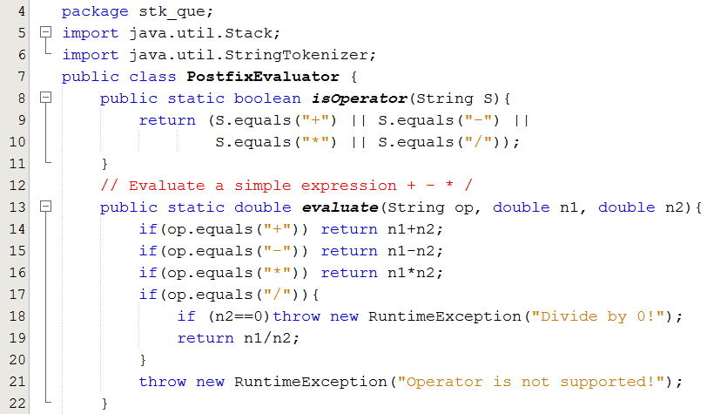
Stack: Demo 5…

Slide 24
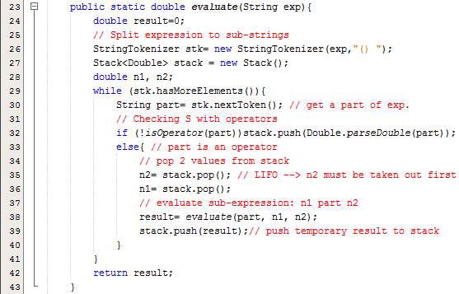
Stack: Demo 5...

Slide 25
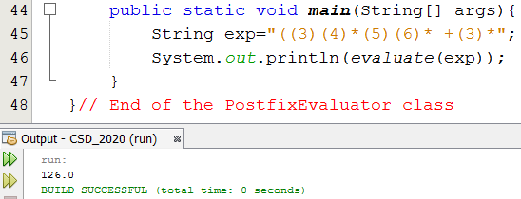
Stack: Demo 5.
Evaluating a simple postfix expression.

Slide 26
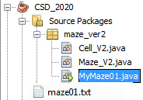
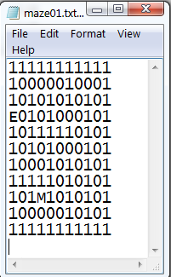
Stack: Demo 6, The Maze Problem
Result:
11111111111
10000010001
10101010101
E0101000101
10111110101
10101000101
10001010101
11111010101
101M1010101
10000010101
11111111111
Result path :
[(3,0, E), (3,1, 0), (2,1, 0), (1,1, 0), (1,2, 0), (1,3, 0), (1,4, 0), (1,5, 0), (2,5, 0), (3,5, 0), (3,6, 0), (3,7, 0), (4,7, 0), (5,7, 0), (5,6, 0), (5,5, 0), (6,5, 0), (7,5, 0), (8,5, 0), (9,5, 0), (9,4, 0), (9,3, 0), (8,3, M)]
BUILD SUCCESSFUL (total time: 0 seconds)

Slide 27
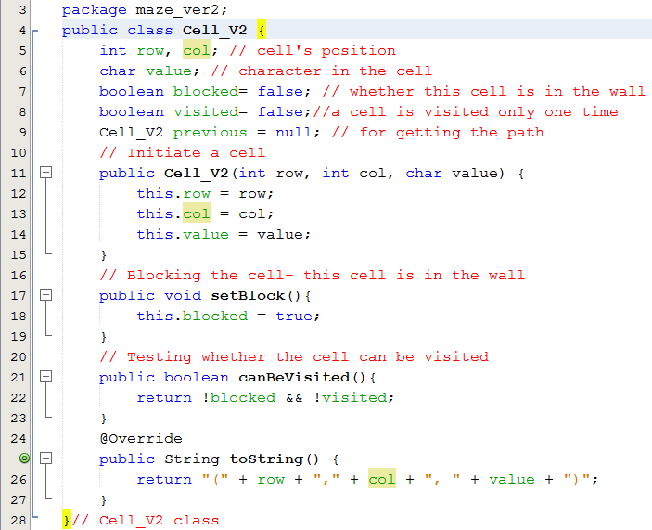
Stack: Demo 6: The Maze Problem…

Slide 28
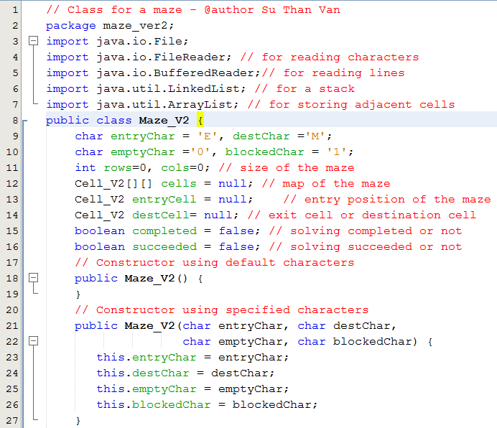
Stack: Demo 6: The Maze Problem…

Slide 29
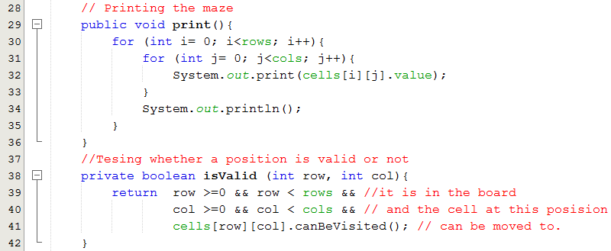
Stack: Demo 6: The Maze Problem…
Một cell hợp lệ khi tọa độ của nó nằm trong bàn cờ và có thể đến được

Slide 30
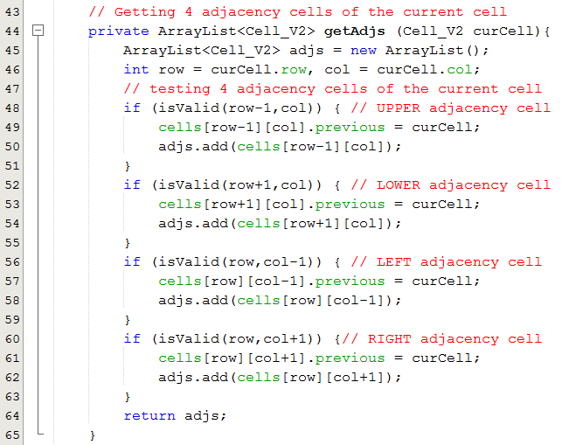
Stack: Demo 6: The Maze Problem…
row-1, col
row,
col-1
row,
col
row,
col+ 1
row+1,
col

Slide 31
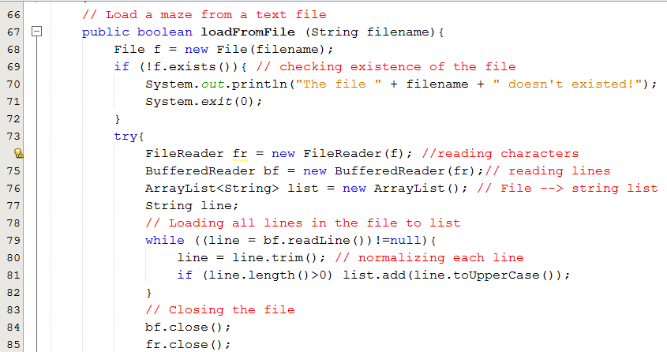
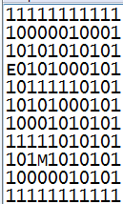
Stack: Demo 6: The Maze Problem…

Slide 32
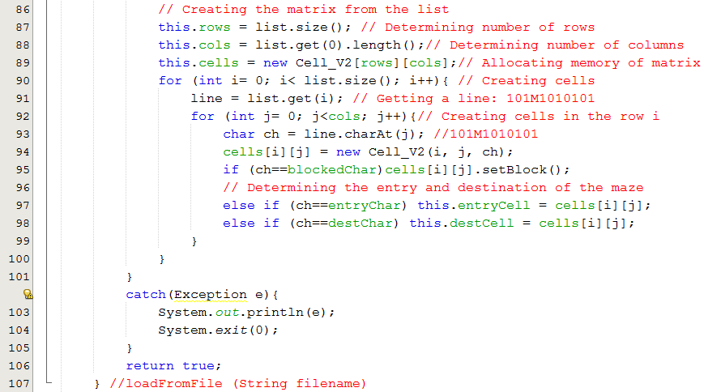
Stack: Demo 6: The Maze Problem…
11111111111
10000010001
10101010101
E0101000101
10111110101
10101000101
10001010101
11111010101
101M1010101
10000010101
11111111111

Slide 33
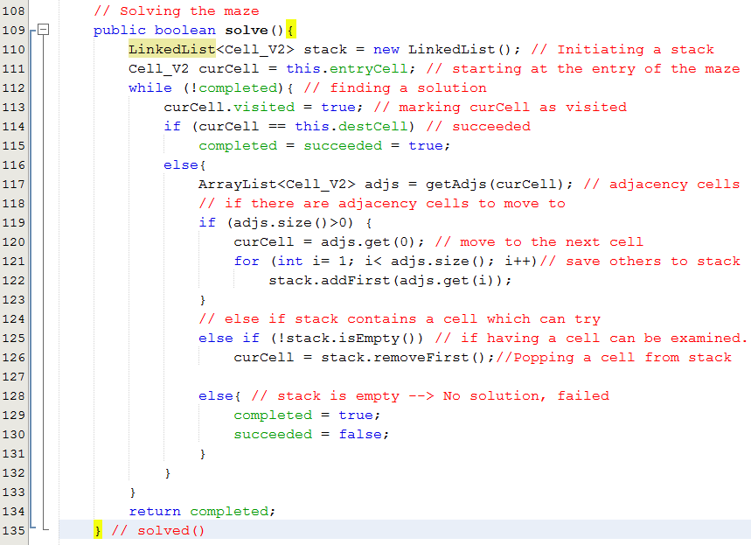
Stack: Demo 6: The Maze Problem…
11111111111
10000010001
10101010101
E0101000101
10111110101
10101000101
10001010101
11111010101
101M1010101
10000010101
11111111111

Slide 34
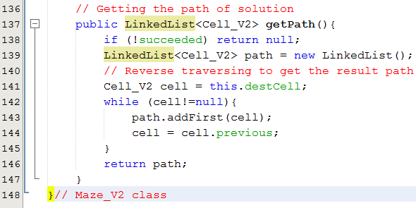
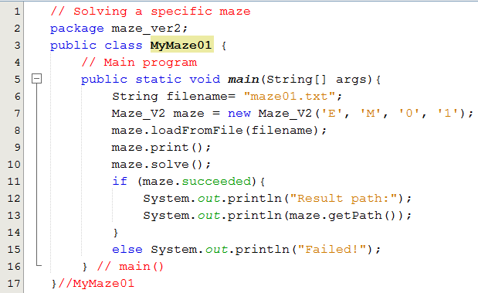
Stack: Demo 6: The Maze Problem…

Slide 35
2- Queues
A queue is a waiting line that grows by adding elements to its end and shrinks by taking elements from its front
A queue is a structure in which both ends are used:
One for adding new elements
One for removing them
A queue is an FIFO structure: first in/first out
Where a queue should be used?
A queue should be used when processing order of data is the same as creating order.
Examples:
Queue for customers who are waiting for paying money in a shopping store.
Printing server: A program receives all printing requirements in a network environment.

Slide 36
Queues: How to Implement a queue?
Step 1: Choose a linear storage (an array or a linked list).
Step 2: Implements basic methods which will make a list as a queue such as:
clear() — Clear the queue
isEmpty() — Check to see if the queue is empty
enqueue(el) — Put the element el at the end of the queue
dequeue() — Take the first element from the queue
firstEl() — Return the first element in the queue without removing it.

Slide 37
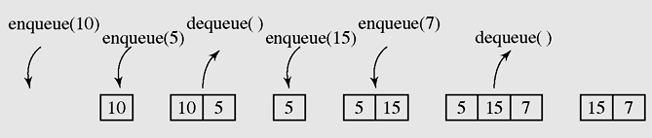
Queues …
A series of operations executed on a queue
Array queue vs Linked list queue
List | Using array → linear group | Using linked list → linear group
Queue enqueue(x) dequeue() | Add to end → enqueue(x) →O(1) Remove from beginning → dequeue() → Shift up → O(n) → Improvement: circular array → O(1) | Add to the end → O(1) Remove from beginning → O(1)

Slide 38
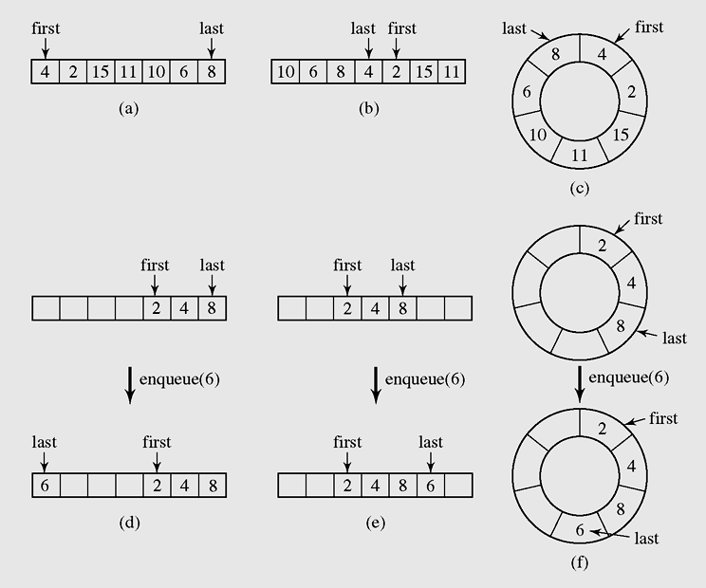
Queues using circular array
If an array is used to store elements of a queue the 2 indexes must be used to mark the beginning and the last positions.
If we do not want to shift elements when an element is pick out the queue then a circular mechanism is used.
➔ What configuration will describe the queue is full?
remove
Add
Circular array
remove
Add
Add
remove
Figure 4-9 Two possible configurations in an array implementation of a queue when the queue is full

Slide 39
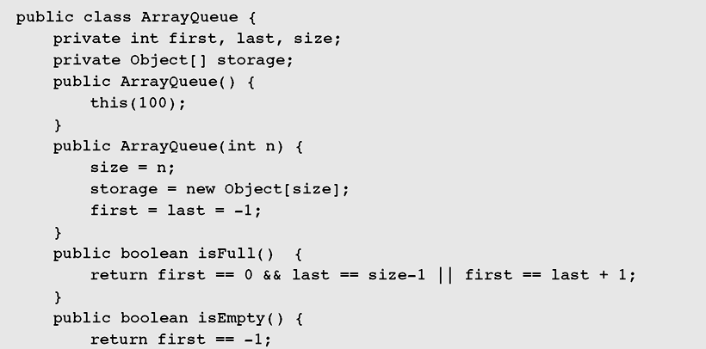

Queues using circular array…
Read by yourself
Figure 4-10 Array implementation of a queue

Slide 40
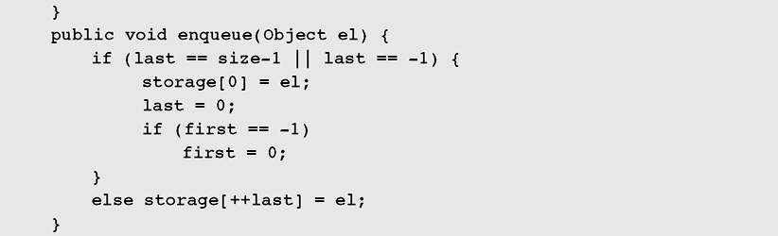
Queues using circular array…
Read by yourself
The queue is full or empty → Add to the position 0, circular adding
Figure 4-10: Array implementation of a queue (continued)

Slide 41
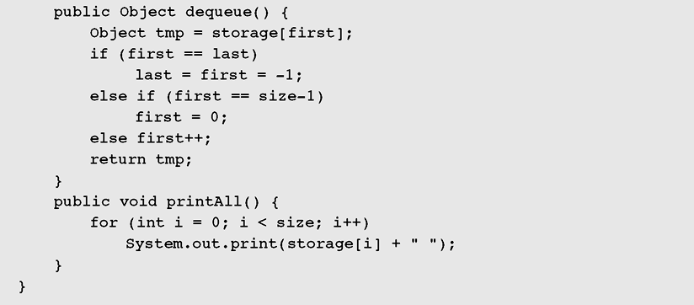
Queues using circular array…
Read by yourself
In case of only one element
In case of first in the end of array → circular increasing
Normal case
Figure 4-10 Array implementation of a queue (continued)

Slide 42
Queues using Linked lists
Remember
One side for adding an element to the queue(enqueue)
- Other side for removing an element (dequeue)
Operation | Methods are used
Enqueue an element | add(x), addLast(x)
Dequeue an element | remove(), removeFirst()

Slide 43
Queues: Demo 7
This demonstration will depict activities in a shopping store. Customers buy products, an accountant will print an invoice for each customer waiting in a queue.
Activities of customers and accountant’s activity are proceeded concurrently → Multi-thread programming is used.
In this demonstration, multi-threading programming in Java is introduced.

Slide 44
Queues: Demo 7…
Introduction to multi-threading:
CPU has some processors and it is multi-core. A core is a processor.
A core may contain some instruction pipelines. Each pipeline can run a method independently. So, in a process (program in running), some methods can really performed concurrently
A thread is a specific code unit (a method run()) in running. Each language supports it’s own way to make an object being a thread.
A process can have some threads. As default, a process has ONE thread of the main(…) method.
Threads in a process are managed by a scheduler implemented in operating system or run-time environment (Java Virtual Machine, java.exe)

Slide 45
Queues: Demo 7…
Multi-threading in Java:
Java supports multi-threading. The java.lang.Runnable interface declares a method of a Java thread, public void run(void).
The topmost class of Java thread is the java.lang.Thread. This class implemented the Runnable interface.
2 ways to create threads in Java
(1) Create a class implementing the Runnable interface
(2) Create a sub-class of the Thread class should be defined in which the run() method should be overridden appropriately.
The following demonstration depicts both of two ways above.

Slide 46
Queues: Demo 7…
Multi-threading in Java:
Each thread has a name and common use methods of threads are:
start() : register the thread with the scheduler then it’s run() method is called aqutomaticaaly when it is chosen by the scheduler.
stop(): un-register the thread from the scheduler. This method is not safe in case of there is common resource between threads.
yield(): inform to the scheduler that it want to stop using CPU → Yielding CPU to other threads → A way to stop a thread safely.
sleep(milliSec) : Pause the thread a duration
isAlive(): checking existence of a thread .
For more details:
https://docs.oracle.com/en/java/javase/16/docs/api/java.base/java/lang/package-summary.html

Slide 47

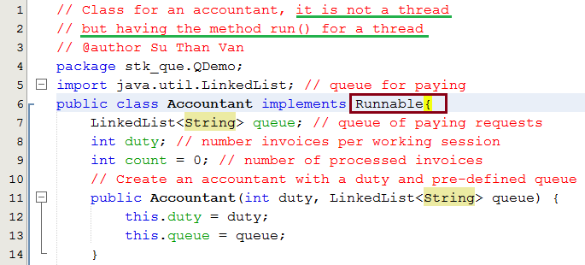
Queue: Demo 7
- Thread for accountant’s activity will be implemented using the Runnable interface.
- Class for a customer will be sub-class of the Thread class.

Slide 48
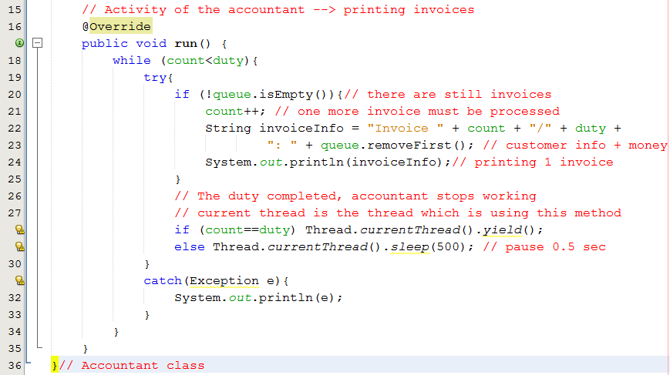
Queue Demo 7…

Slide 49

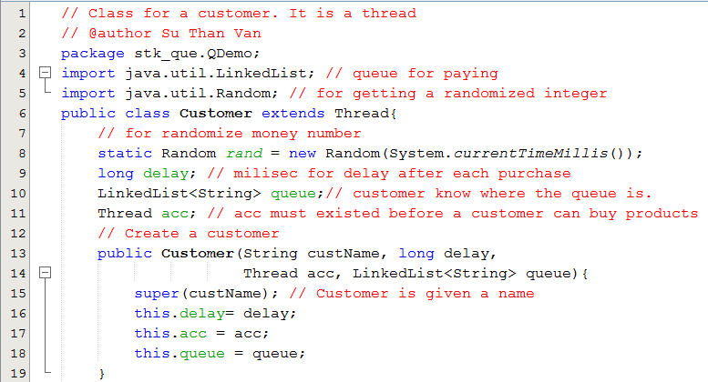
Queue Demo 7…

Slide 50
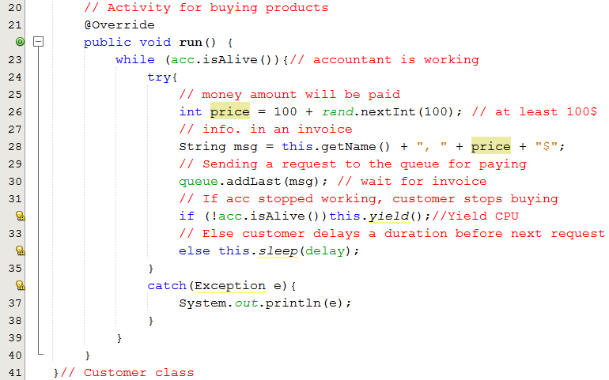
Queue Demo 7…

Slide 51
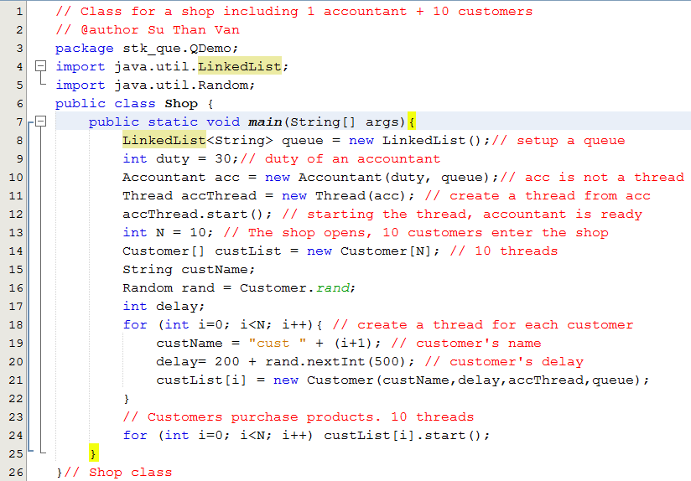

Queue Demo 7…

Slide 52
3- Priority Queues
Priority: External factor is applied on each data object. It is commonly an integer.
In priority queue, each element is assigned it’s own priority.
In de-queue operation, the element having the highest priority must be chosen.
When an data object is en-queued, it will be put to a suitable position → After a new element is added to the end of the queue, some updates may be performed to ensure that the highest priority element is put at the beginning of the queue.

Slide 53
A Priority Queue using Array
Init empty queue
Enqueue 5
Enqueue 3
Enqueue 7
Enqueue 1
Dequeue → 1
Enqueue 0
Enqueue 10
Dequeue → 0
Enqueue 6
Dequeue → 3
Evaluation:
(Based-on shift operations)
En-queue:
The best case, highest priority → Adding to the end → O(1)
The worst case, lowest priority → Adding to the beginning → O(n)
- De-queue: Removing from the end → O(1)
5
5 | 3
7 | 5 | 3
7 | 5 | 3 | 1
7 | 5 | 3
7 | 5 | 3 | 0
10 | 7 | 5 | 3 | 0
10 | 7 | 5 | 3
10 | 7 | 6 | 5 | 3
10 | 7 | 6 | 5

Slide 54
Priority Queues (continued)
Where priority queues are used?
Schedulers in operating systems → Priority schedulers
Schedulers in automatic processing applications.
Priority queue implementations:
(1) Using a totally ordered list (array or linked list) → Cost of en-queue operations.
(2) A heap, it will be introduced in the chapter Trees.

Slide 55
Learning Outcomes

LO2.1 Define stack and queue.
LO2.2 List and demonstrate the operations common to stacks and queues.
LO2.3 Describe specific tasks to which stacks and queues are suited.
LO2.4 Apply stacks to a specific application.
LO2.5 Apply queues to a specific application.
LO2.6 Write programs to implement stack and queue in Java programming language.
LO2.7 Define and explain the need of priority queue.







Slide 56
Summary
A stack is a linear data structure that can be accessed at only one of its ends for storing and retrieving data.
A stack is called an LIFO structure: last in/first out.
A queue is a waiting line that grows by adding elements to its end and shrinks by taking elements from its front.
A queue is an FIFO structure: first in/first out.

Slide 57
Ôn tập – Viết vào vở
1- Danh sách hạn chế là gì?
2- Stack được gọi là danh sách hạn chế vì lý do gì?
3- Hai tác vụ cơ bản nhất trên stack là gì?
4- Nếu DSLK được dùng để hiện thực stack, hai tác vụ cơ bản trên stack có độ phức tạp thời gian là bao nhiêu?
5- Khi nào stack được khuyên dùng?
6- Queue được gọi là danh sách hạn chế vì lý do gì?
7- Hai tác vụ cơ bản nhất trên queue là gì?
8- Nếu DSLK được dùng để hiện thực queue, hai tác vụ cơ bản trên queue có độ phức tạp thời gian là bao nhiêu?
9- Khi nào queue được khuyên dùng?
10- Với bài toán đổi số hệ 10 sang hệ 2, stack hay queue được khuyên dùng?
11- Sử dụng lớp java.util.LinkedList như là một queue có được không? Tại sao?
12- Hàng đợi ưu tiên được hiện thực bằng gì?

Slide 58
Ôn tập – Viết vào vở
13- Suppose that a stack of integers, named stk, is empty. Examine the following code:
stk.push(1); stk.push(3); stk.push(5); stk.push(7);
stk.push(9); stk.push(10); stk.push(11); stk.push(13);
while (!stk.empty()) {
stk.pop();
System.out.print(stk.pop() + “,”);
}
What we can see in the output?

